Slide 1


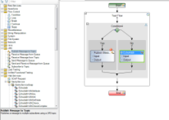

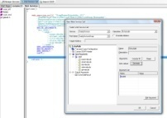

ST
Architecture
February 11
API
LoadRunner
QC
API
Executable Runner
API Proxies
VTD
API
User
shell
BPT / LR project
Common
UI
Toolbox
tabs
Data
runs
ST
Remote Rep. (QC, LAR)
ST Facade
Grid
Flow
Save to QC Save as BPT
uses
uses
uses
uses
uses
Model
Services
Script Folder
Model
Activity1
Services
Workflow
Saves
to
/snapshots
Script_operations
.xml
DB
run script
IProp
Composite
Activity1
IProp
snapshot
saved in
Code
Activity
Section1
Section2
upgrade
Data fetcher
report
IProp
dto mapper
JVM
Checkpoints.cs
main.cs
SharedUserCode
.cs
User events
Xml data
pv. schema
addin
loop
RT Platform
translates to
xml
xml
license
Link2Xsd
Flow
translation
Data cursor
Bind Direction
uses
Compiles to
Compiles to
DT Platform
Activity1
source
XPathGetter
runs
Script.dll
HP.ST.
Types.dll
Metadata repository
Test
Destination
uses
Data links
Activity2
In
Directions
Setter Decorator
.usr, vugen*.cs (load enabled)
/ActivityData
Metadata2
Metadata1
source
Local
cache
Section1
Sec. 2
Schemas
Schemas
Environemnt
variables
Data
queries
Checkpoints Manager
Expression
Private storage
IProp
IProp
XPathGetter
Prototype
Prototype
/Embedded Repository
/Metadata Cache
Dynamic metadata
Implement SDK
CP rule
actual
(optional)
Extensions
CP rule
CPObjVal
Infra
Activities
Data sources
expected
QC
Saver
Static metadata
Upgrader
Flow control
Excel
DB
Implement SDK
WebServiceCall
Xml
Defined
in
Addin
Importers
HTTP
Extensions
Soap Request
my.addin
Signature.xml
binaries
Defined in
JMS
HTTP
Wsdl Importer
REST
REST
Service Test
Service Test
QTP
QTP

